Slide 1


State of Philanthropy in Southern Arizona
Presented by Jenny Flynn
President & CEO
Community Foundation for Southern Arizona

Slide 2
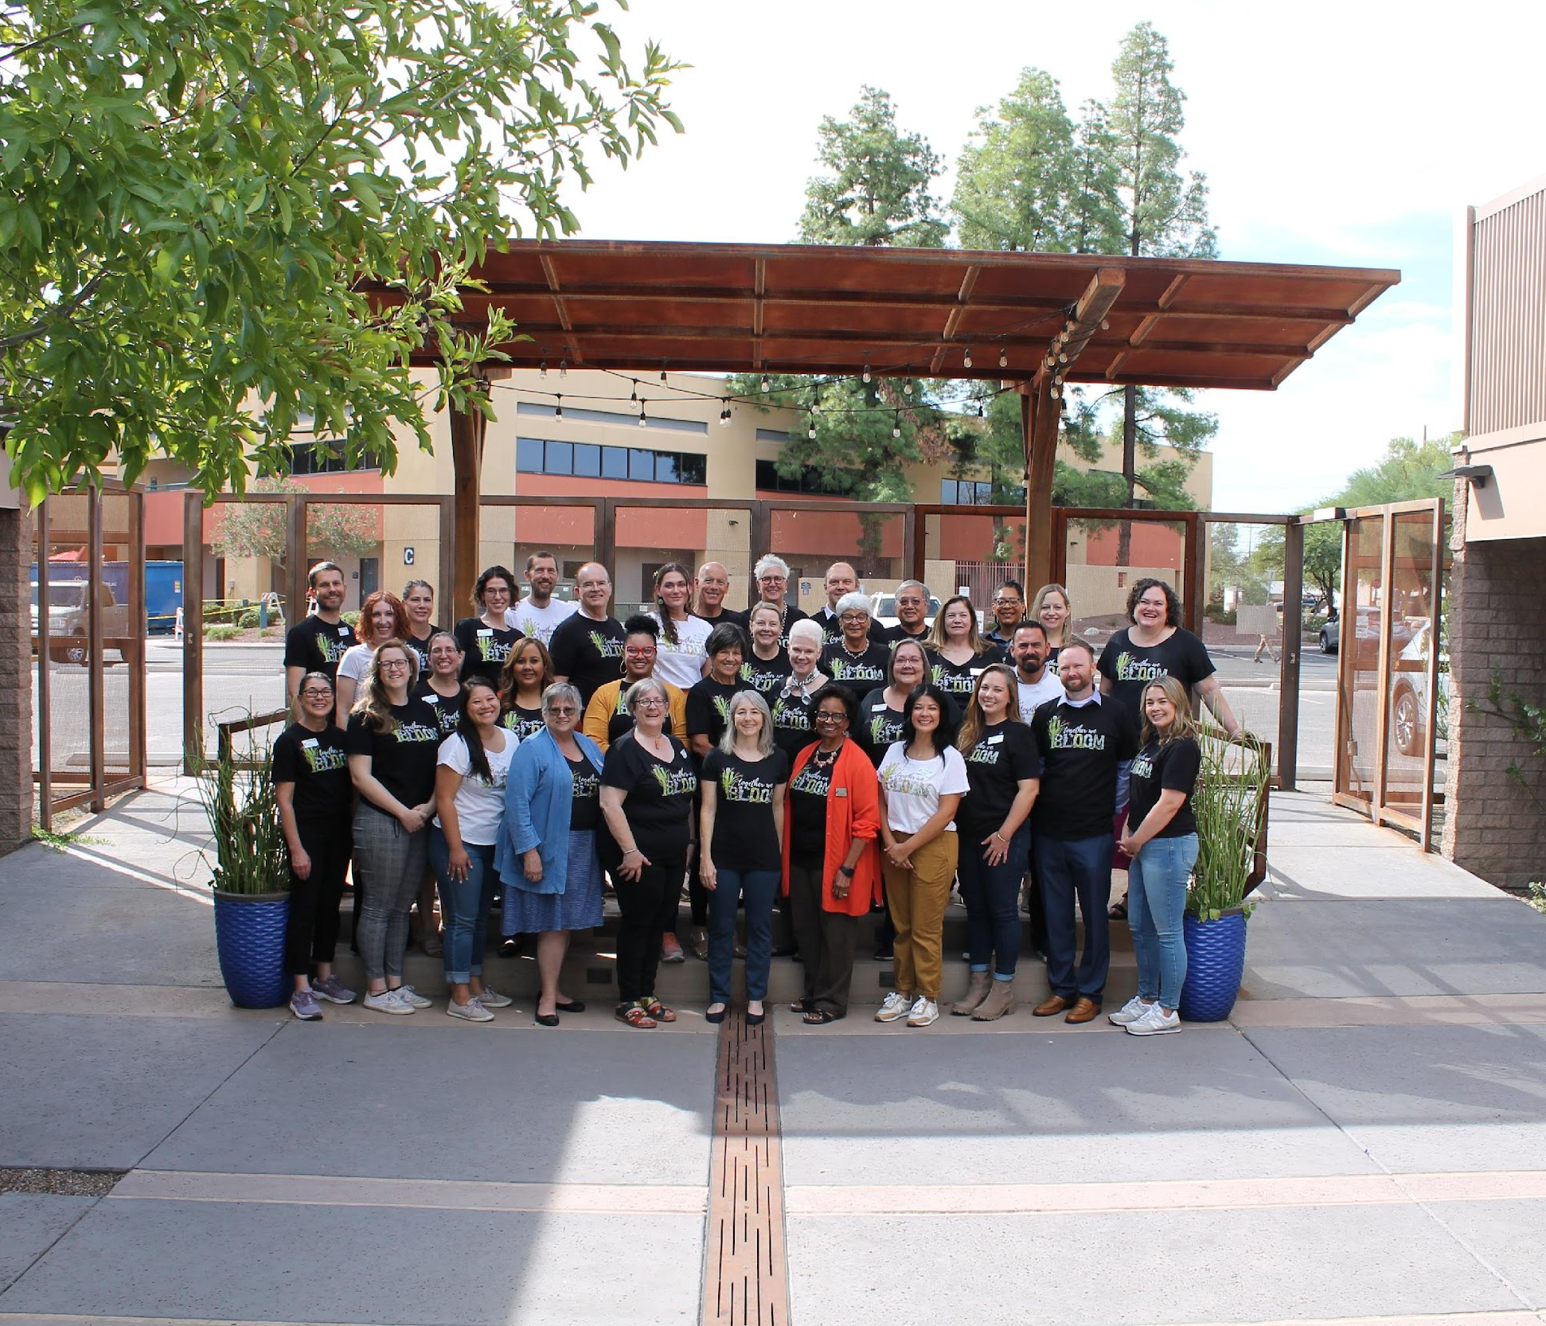
Community Foundation for Southern Arizona
Impactful Philanthropy
The Community Foundation for Southern Arizona is a hub for generous and community-minded individuals, families, and nonprofit organizations that care about Southern Arizona.
Service Area
We focus our service on counties south of the Gila River including Pima, Santa Cruz, Graham, Greenlee, Yuma, Cochise and some of Pinal County.
Vital Nonprofit Support
We are headquartered at the Community Foundation Campus, a nonprofit coworking space that provides a platform for collaboration. Our Center for Healthy Nonprofits offers free and low-cost training and capacity building for nonprofits.

Slide 3

Topics for Today
Current Outlook for Nonprofits
Context for Donors–tax law, uncertainty, overview of responsive strategies
Giving Is Being Transformed
Setting the State for Renewal–future orientation

Slide 4
What is 1 word that comes to mind when I ask you about the state of philanthropy in Southern Arizona?
Notes:
Bring paddles! Use your paddle to write. You may have to share with your neighbor

Slide 5
Current Outlook: Nonprofits Under Strain
We live in VUCA (Volatile, Uncertain, Chaotic, and Ambiguous) times.
In March 2025, the Trump Administration proposed a “freeze” on all nonprofit funding, and has since worked to reduce funding availability through appropriations
Through policy actions such as OBBB Act, immigration efforts, etc. the Federal government has increase community vulnerability increasing community need.
Organizations have been significantly impacted by federal government action.
More than 40% of organizations have reported being affected by the federal government’s funding reductions over the past year.
Policy shifts have significantly impacted programs for marginalized communities, including LGBTQ+, immigrant, women, low-income, and rural communities
Staff and program operations have been interrupted.
15-20% of organizations have laid off staff, made hiring freezes, or reduced staff hours
Impacts are currently estimated at over 10,000 Southern Arizona residents and counting
Notes:
Data from fall 2025

Slide 6
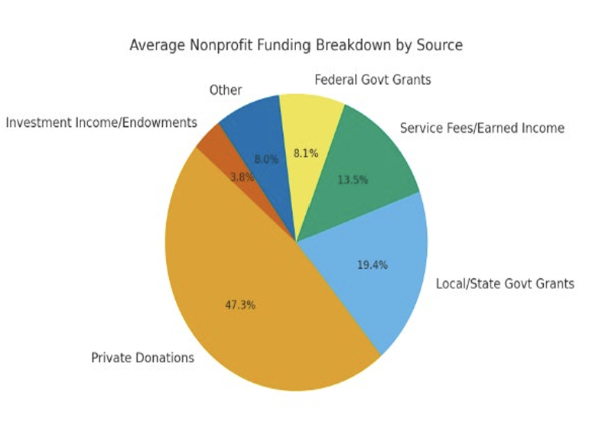
Nonprofit Funding Composition
Private Donations: Largest share of funding comes from private donations.
Local/State/Government Grants: Nearly 19% of funding.
Federal Grants: 8%
Earned Income: 13%
Investment/Endowment: 4%
Nearly 30% of nonprofit respondents budgets in Pima County are government funded. With federal government cuts impacting funding at all levels, this leads to major service reduction.

Slide 7
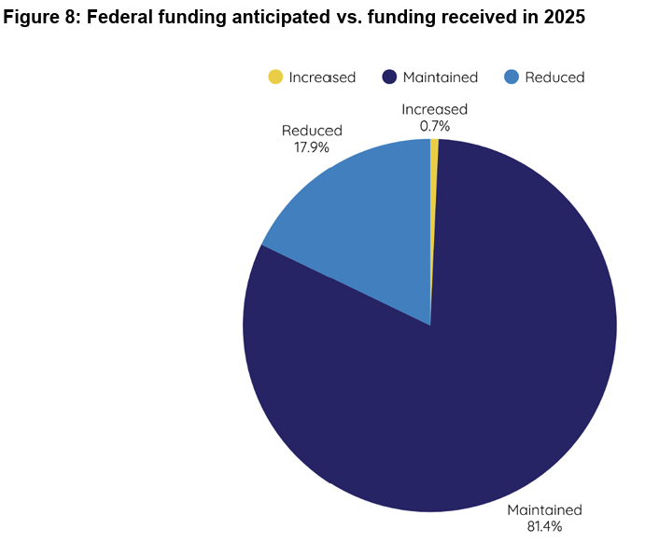
Layoffs: Federal Funding Impacts
43.6% of respondents indicated that changes to federal funding impacted their organization.
18.6% indicated that they were unsure whether federal changes have impacted their organization.
Between 15-20% of nonprofits indicated that funding changes in 2025 had led to active layoffs.
  Small orgs: between 1-5 staff impacted
  Medium orgs: between 8-20 staff impacted
  Large orgs: Up to 60 staff impacted
Notes:
“We expect to layoff 3 to 5 FTEs at the end of the year, which equals approximately 20% to 30% of staffing.” – Pima County nonprofit
“2 since January 2025, additional 2 expected within 6-8 months” – Pima County youth education nonprofit with a staff level in the 15-30 range
“Given the uncertainty of federal funding, we made the painful decision to reduce staff earlier this year.” 35 FTE were laid off from a staff of about 200, others chose to depart and positions were not refilled – Pima County nonprofit
“While we do not have government funding, we did go through a RIF to right size the organization in light of unpredictable private donations and grants. Two senior level positions were eliminated in March 2025.” – Pima County nonprofit serving children and youth

Slide 8
At the Same Time: Increased Demand for Service
Figure 11. Services reported to be in high demand across qualitative responses
Category | Examples of Services in High Demand
Food & Basic Needs | Emergency food, SNAP assistance, hygiene & menstrual kits, meal programs (esp. seniors), utility aid
Housing & Emergency Assistance | Rent & utility assistance, eviction prevention, emergency shelter, home vouchers
Youth & Education | After-school & summer programs, mentoring, scholarships, restorative justice programming, GED/ESL
Transportation | No-cost transport for seniors, school-based transit, rural areas, medical visits
Healthcare & Mental Health | Prenatal care, trauma-informed education, counseling, mental health services
Legal & Immigration Services | Know Your Rights, pro se support, detention center legal help, LGBTQ+ information access
Workforce Development | Job readiness programs, day labor, economic opportunity services (esp. for displaced workers)
Community Safety & Advocacy | Safe spaces, public policy education, media literacy, response to violence, public land protection, LGBTQ+ advocacy
Veterinary Services | Emergency veterinary care (esp. for low-income or unhoused individuals)
Animal Therapy / Programming | Therapeutic services, foster pet care, animal-assisted programming
Cultural & Arts Programming | Book requests, art education, museum visits, teacher professional development, local cultural services

Slide 9
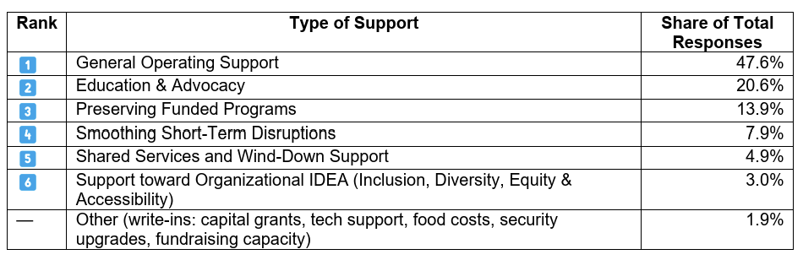
Where Nonprofits Need Support
Notes:
General operating support, especially multi-year support, is a key lever to enhance nonprofit resilience.

Slide 10
How are donors and others responding?
Notes:
Write a few words on your paddle

Slide 11



Impacts Beyond Government Funding
Local & State: With federal funding cuts and restrictions, local and state grants/appropriations, which were once reliable, are now up in the air for many nonprofit organizations – leading to larger cuts.
Sector-Wide Tension: Corporations and foundations are often “tightening the belt” on giving. Grant opportunities in the private sector are seeing significantly increased competition.
Impacts to Donor Confidence: Some donors are taking a “wait and see” approach in relation to funding, which has increased the strain on top of cuts to government funding. Layered in: changes to tax incentives of OBBB.
Notes:
Insights on purpose report 2026 (national, Chronicle of Philanthropy) validates the hesitance of some private philanthropy/donors, “58% of surveyed nonprofit leaders reported that in the last year, their funders were more hesitant to fund in the same amount or at all.” 75% report increased competition for funds.

Slide 12
Grantmaker Responses to Federal Uncertainty
Private Foundations
Some private foundations have been more generous with funds, knowing that funding is tight for nonprofits
Changing from open invitation
Switching funding deadlines with limited communication
Increased competition for funding leading to lower award amounts
Differentiation between lean in and hold back funders
Government Funders
Federal level funders are shifting focus from DEI to rural communities and economic development
Government shutdowns have delayed administrative action of anticipated grants
State and local funding for grant opportunities have significantly reduced pending additional federal cuts
Notes:
Corporate foundations are in many cases steering clear of “hot buttons” and rethinking timing and approach to giving given new 1% floor for charitable giving

Slide 13
OBBB Act: Changes to Charitable Tax Code
Beginning in 2026, new limited charitable tax break for donors – $1,000 for individuals or $2,000 for joint filers
Approximately 90% of filers will have a federal tax incentive to give for the first time.
  Reengagement of mid-level giving is anticipated this year if there is clear communication about the financial benefit of giving
  Strategy: “Your gift now qualifies for a tax deduction, even if you don’t itemize.” Get this messaging out early–7 times, 7 ways.

Slide 14
OBBB Act: Charitable Tax Code Changes
High-income donors will experience a small reduction in tax savings from giving, with 0.5% of income given no longer deductible and top marginal deductions dropping by two cents per dollar donated.
Large donors are likely to bunch multiple years giving into one tax year or they will delay and restructure their giving through DAFs for Family Foundations.
Strategy: Optimize long-term giving options for pledge or planned gifts. Adjust your marketing to explicitly welcome gifts that can cover multiple years, DAF and foundation gifts as tax savvy.

Slide 15
OBBB Act: Charitable Tax Code Changes
Corporations will need to donate at least 1% of their taxable income to qualify for a dedication.
Businesses that were previously already doing more may scale back, while businesses not participating may significantly increase partnership
Strategy: Strengthen corporate partnerships and position strategic growth opportunities that are mission aligned. Look for ways to leverage market opportunities, such as when your mission positively impacts their customers or employees

Slide 16
OBBB Act: Charitable Tax Code Changes
Doubles estate tax exemption to $15 million per individual, affecting high-net-worth families.
Conversations about building a legacy become more important.
Strategy: Encourage planned giving through wills, beneficiary designations, and charitable trusts.

Slide 17
Where does this leave nonprofits?
Exhausted & Strained: We are “beyond stressed, switching between programs during the day while also managing a Café and Plant Nursery.”
High Administrative Burden with Low Staff: “We operate on minimal administrative staff…reducing staffing any further than our already minimal crew would ultimately lead to closing our doors permanently.”
Underserved Community Members: “I have many stories from individuals not having enough food to live on and those about to be evicted”
Reduced Staff Morale: “Everyone is worried that they need to start looking for another job.”
Notes:
“Layoffs have devastated staff morale, almost doubled attrition rates, and seen a uptick in the acuity of need by our clients.” – Pima County Health and Human Services nonprofit

Slide 18
How does this resonate with what you are hearing and experiencing?
Notes:
Write a few words on your paddle

Slide 19
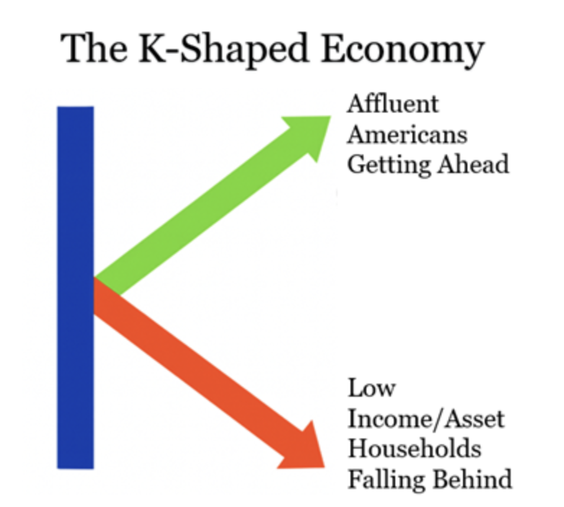
Giving Is Being Transformed
K-shaped economy
Intergenerational transfer of wealth
VUCA external environment
Tax law coming into effect
Generational experiences and preferences
  Dual strategies needed
Leadership is critical

Slide 20

Top Motivations for Giving for Gen Z and Millennials
Family influence: 63%
Passion for a cause: 63%
Connection to the local community: 61%
Influence from friends: 48%
Personal journey or life experience:43%
Religious or spiritual beliefs: 41%
Notes:
I am going to do a brief preview of some findings from a study CFSA did in 2025 about engaging young professionals. More to come.

Slide 21




Younger Generation Giving Patterns
Younger donors tend to give larger gifts to fewer causes
Over half of young donors began giving before 20 years old.
Faith-based organizations and places of worship continue to be among the top four most frequently given sectors among all generations
Gen Z and Millennials are deeply guided by personal values of social justice and systems change – often opting to donate to causes around LGBTQ+ rights, racial and gender equity, environmental stability, and inclusive practices.

Slide 22
What do younger people in Southern Arizona feel connected to?
Education & Youth Organizations
Basic Needs & Social Services
Environmental & Animal Welfare
Human & Civil Rights
Health & Wellbeing
Immigration Reform

Slide 23





Young People Motivation for Giving in Southern Arizona
Personal connection to organization & impact
Community & societal wellbeing
Values & responsibility
Youth & Future Investment
Organizational leadership & mission of organization

Slide 24
Reaching Younger Audiences
Prioritize systems change work (particularly to engage Gen Z and Millennial donors)
Younger audiences want to prioritize volunteering and skill building over dollar donations
Breakdown barriers to board service for younger people
Make giving manageable for people on a budget – partner with workplace campaigns to take money directly from paychecks.
More on March 24, noon-1:00 on Zoom
Engaging Young Professionals

Slide 25
What is one thing you wish for from your leaders?
Notes:
Use your paddle

Slide 26
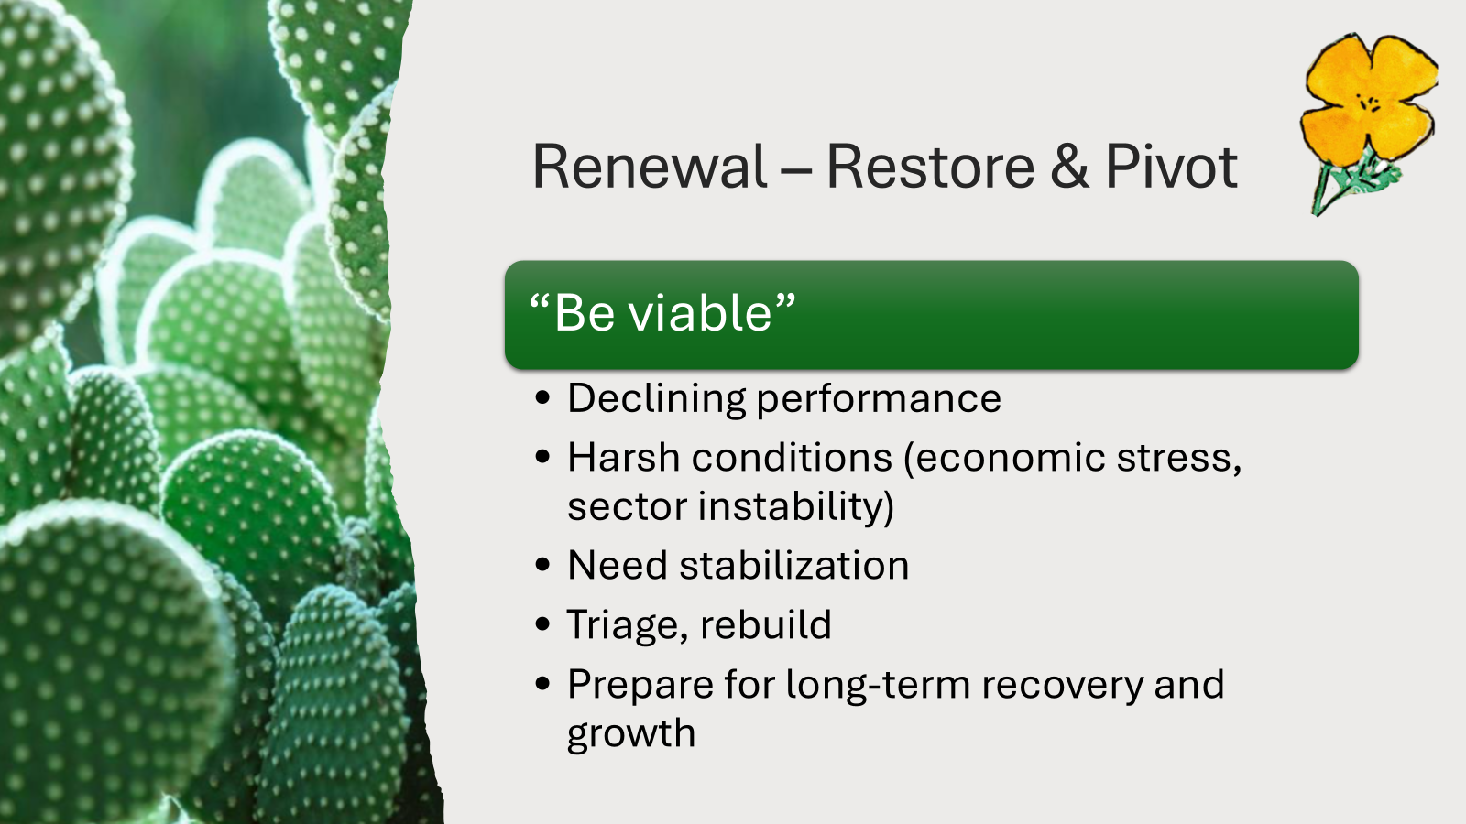
Notes:
BCB Strategy Palette – strategy to focus on under very harsh conditions, planting a seed. In 10 years, I hope to see our nonprofit sector rebuilt and better than before, claiming their place as economic engines, partners to business, donors, and government, desirable employers, and systems changemakers.

Slide 27
Future Orientation, an Element of Renewal
A future‑oriented nonprofit tells the truth about how hard things are, while still making deliberate, values‑aligned choices about what it is building next—and invites others to help shape that future.
Risk | How Future Orientation Responds
Toxic positivity | Names threats explicitly; grounds hope in action and choice
Denial | Treats uncertainty as data, not something to suppress
False certainty | Uses scenarios and contingencies, not predictions
Emotional suppression | Makes room for grief and fear alongside purpose
Burnout disguised as optimism | Sets limits, pauses work, reduces overload
Notes:
Future‑oriented leaders say things like:
“Some doors are closing. We are grieving that.”
“Here’s what we are protecting at all costs.”
“Here’s what we are experimenting with next.”
“Here’s what success looks like under these conditions.”
“The next year will be difficult. Here’s how we can move forward anyway.”
They avoid:
“At least…”
“Look on the bright side…”
“We just need to stay positive…”

Slide 28

Questions

